Slide 1
Employee Data Analysis using Excel
STUDENT NAME: AKSHAYA.M
REGISTER NO : 312216757 & asunm1659312216757
DEPARTMENT : B.COM ACCOUNTING &FINANCE
COLLEGE : SHRI KRISHNASWAMY COLLEGE FOR WOMEN

Slide 2
PROJECT TITLE
Employee Performance Analysis using Excel

Slide 3


AGENDA
Problem Statement
Project Overview
End Users
Our Solution and Proposition
Dataset Description
Modelling Approach
Results and Discussion
Conclusion
3/21/2024 Annual Review

Slide 4

PROBLEM STATEMENT
* To analyze the performance of employees within a company over a specified period using various
Performance metrics , such as sales target, project completion rates, attendance, and customer feedback.
* The goal is to identify top performers, areas of improvement, and any trends or patterns that may inform
HR decisions and strategic planning.
* The management team wants to use this data to understand individual and team performance, recognize
high performing employees, and provide supported where needed.
TASKS:
Data collection and preparation
Performance Metrics Calculation
Analysis
Visualization
Recommendations
Success Criteria

Slide 5

PROJECT OVERVIEW
DATA COLLECTION AND PREPARATION :
* Collect data from relevant sources, such as sales reports, project management tools and attendance
Logs
2. KPI CALCULATION :
* Calculation performance metrics for each employee.
3. DATA ANALYSIS :
* Used Excel tools (functions, pivot tables , etc) to perform a detailed analysis
* Identify trends and patterns within data, such as top performing departments or employees requiring
additional support.
4. VISUALIZATION AND REPORTING:
* Used charts, graphs, and tables to communicate the analysis effectively.

Slide 6


WHO ARE THE END USERS?
Management Team : To make informed decisions regarding employee recognition, promotions, and Resource
Allocation.
Human Resources(HR) : To manage employee development, performance appraisals, and training programs
Departments Head/Team Leader : To assess the performance of their respective teams and individuals within
Their departments.
C-Suite Executives: To align employee performance with broader organizational goals and strategic initiatives.
Employees ( Indirect End Users) : while employees may not directly interact with the analysis tool, they
Are indirectly affected by the outcomes, such as feedback, training opportunities, and career development
Initiatives resulting from the analysis.

Slide 7

OUR SOLUTION AND ITS VALUE PROPOSITION
Conditional Formatting : In this project we used conditional formatting
for identifying the missing valve and highlights the blank valve.
Filter : Filter uses to remove the blank valve
Using filter option .
Formula : To identify the employees performance
Pivot Table : Leverage Excel’s powerful tools to dissect data,
Uncover trends, and identify outliers, trend analysis for monitor performance
Over time , highlighting improvements or declines
Graph : interactive dashboard create intuitive dashboards with
Charts and graphs that visualize performance data.

Slide 8
Dataset Description
Employees ID - A unique identifier for each employee
Employee Name - The full name of the employee
Employee Type - The department in which the employee works ( e.g., sales, marketing,)
Performance - using formulas to identify the level of performance of employee a score of
Periodic performance reviews
Gender - Male and Female
Employee Rating - employee rating though sales performance
Job title - The role or position of the employee within the company
Supervisor - Employee roles
Business unit - Employee departments
Division - Their division
DOB - Employee date of birth and their details

Slide 9

THE "WOW" IN OUR SOLUTION
Performance Level = IFS(Z8>=5,”VERY HIGH”,Z8>=4,”HIGH”,
Z8>=3,”MED”,”TRUE”,”LOW”)
3/21/2024 Annual Review
9

Slide 10
MODELLING
DATA COLLECTION
This data is collected from edunet dashboard
Describe the methods used to gather data (e.g online surveys ,webscarping, sensors)
Mentioning tools or platforms employed in the data collection process
FEATURE COLLECTION
1.Determine which features might influence the outcome
2.This can include domain knowledge and exploratory data analysis
DATA CLEANING
1. Identifying the missing valve and highlights the blank valve.
2. Filter uses to remove the blank valve
PERFORMANCE LEVEL
1. using formulas to identify the level of performance of employee a score of
Periodic performance reviews
Performance Level = IFS(Z8>=5,”VERY HIGH”,Z8>=4,”HIGH”,
Z8>=3,”MED”,”TRUE”,”LOW”)
Using this formula we use to identify the level of performances
10

Slide 11
RESULTS
11

Slide 12
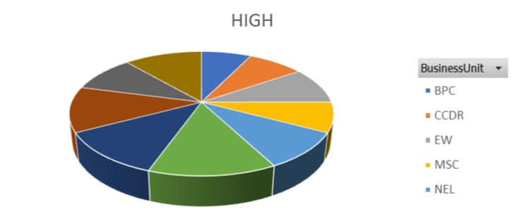

Slide 13
conclusion
Medium level performance employee is high level we need to motive them for better
Outcome we need to motivate them for very high performance level .Trendline for the Medium level
Performance is standard is study state and there is no ups and down in their level performances
Of the employees PL sector employees percentage is more compare to all other departments
PYZ and NEL , and also SVG they are higher in percentage

